Slide 1
Spectral Density Analysis using FFT and Cosine-Tapered Window in the Frequency Domain
May 2020

Slide 2
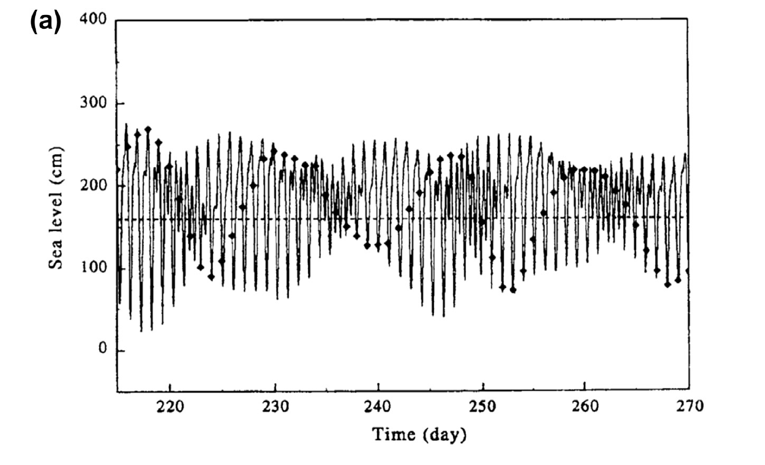
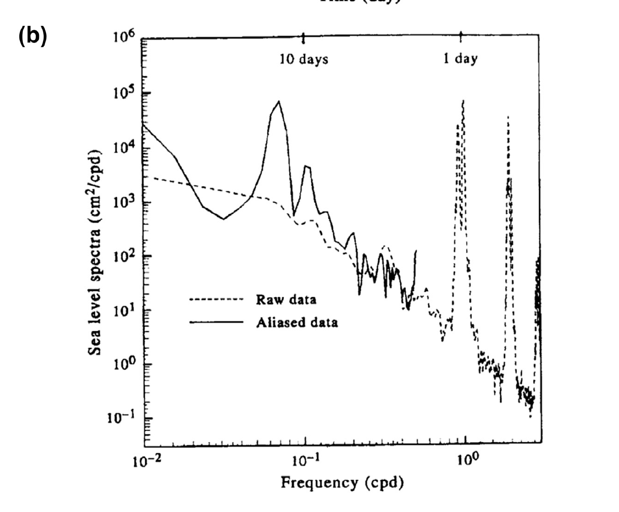
Why Power Spectral Analysis?
We are curious about how much of the variance of a time series is associated with a particular frequency
Fast Fourier Transform: Break the signal into components of different frequencies (e.g. sine and cosine waves) - The signal does not need to be physically like waves!

Slide 3
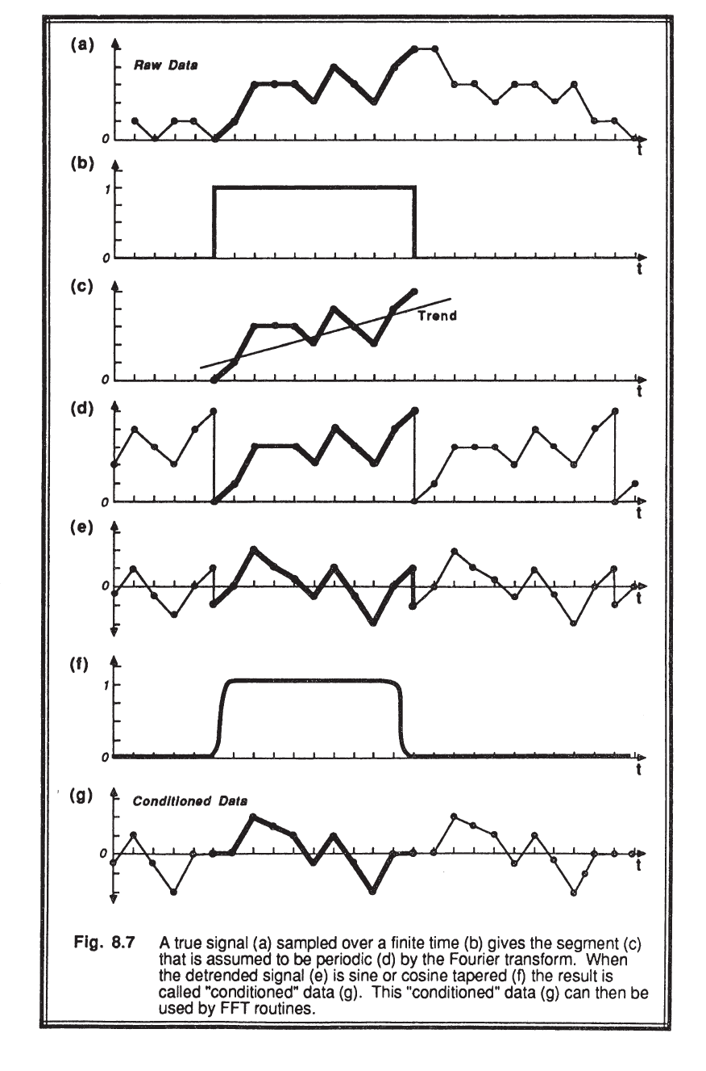
But Before FFT … Let’s Prepare the Time Series
Define the “window” or “band” of interest (b-c)
De-trend (i.e. remove the mean value) the clipped window, and assume your time series to be periodic (d-e)
Smooth the edges of the clipped time series → Cosine-tapered window (f-g)

Slide 4
OpPSD function
[PSD, CLV] = OpPSD(t,series,window,p1,p2, p3, CL, PPLOT)
[PSD,~] = OpPSD (dt, tmp, 1, 1,16,1.0905, 1, 1)
- t: sampling interval in seconds (time vector)
- series: time series (variable vector)
- window: 0 no window
1 cosine taper window
2 hanning window (less smoothing of the edges)
- IF p1 > 0 ==> average in frequency domain (minB,maxB,ratio);
minB = p1: minimum band
maxB = p2: maximum band
ratio= p3: rate of band increase
w = length(serie); TAvg = 1;
- CL: confidency level option (CL=1 means conf. level stored)
- PPLOT: 0 means no plot & 1 generates plot

Slide 5
Smoothing: Cosine Tapered Window
1.- Detrend the time series:
dserie = (serie(index) - mean(serie(index)));
2. - Create an auxiliary function (h) to smooth the edges of the time series (factor = var0/var1 > 1):
var0 = std(dserie)^2;
h = ones(w,1);
alfa = ceil(0.10*w);
h(1:alfa) = 0.5*(1 - cos(pi*(1:alfa)/alfa));
h((w-alfa):w) = 0.5*(1 - cos(pi*((w-alfa):w)/alfa));
dserie = h.*dserie;
var1 = std(dserie)^2; % The variance after the smoothing is reduced
factor = var0/var1; % e.g. 1.04
3.- Compute the FFT and the PSD considering the “smoothing factor”
X = fft(dserie); % The one it has been modified
PSD = PSD + (factor*(abs(X).^2)/(w/t));

Slide 6
Smoothing: Cosine Tapered Window
4.- Smooth the computed PSD using overlapped windows between minB and maxB defined by the “ratio”
PSD_smooth = OpSmooth(PSD,minB,maxB,ratio)
Band = round(minB*(abs(ratio)^(i-1)))
PSD_smooth = sum(serie(k:kl,:))./Band
5.- Confidence limits for the spectrum in terms of a chi-squared distribution (reliability of any spectral peaks)
CLV = OpCLevel([PSD_smooth Frequency])

Slide 7
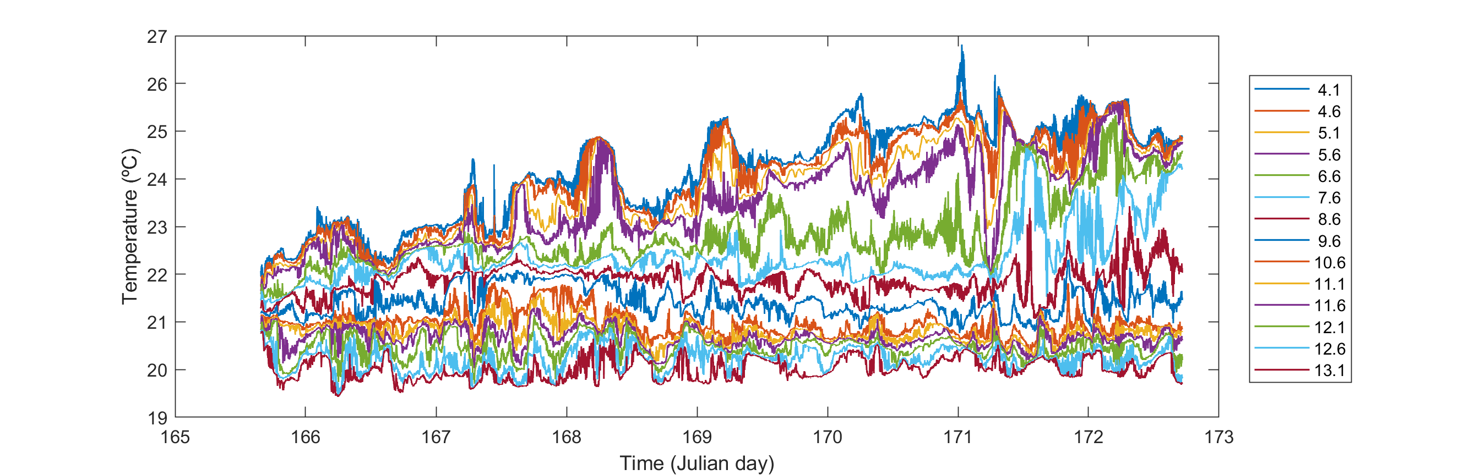
Clear Lake Temperature (summer 2019)

Slide 8
Smoothing: Cosine Tapered Window (1-3)
Using the time series of temperature at ~ 10 m on day 171-1712…
1.- Detrend the time series
2. - Create an auxiliary function (h) to smooth the edges of the time series (factor = var0/var1 = 1.04)
3.- Compute the FFT and the PSD considering the “smoothing factor”

Slide 9
Smoothing: Cosine Tapered Window (4-5)
Buoyancy freq. (N)
4.- Smooth the computed PSD using overlapped windows between minB and maxB defined by the “ratio”
5.- Confidence limits for the spectrum in terms of a chi-squared distribution (reliability of any spectral peaks)
15 min
5 min
PSD to the right of N is not due to a seiche (turbulence)
Use the -½ slope of the PSD to identify reliable peaks (it could be -3/5)

Slide 10
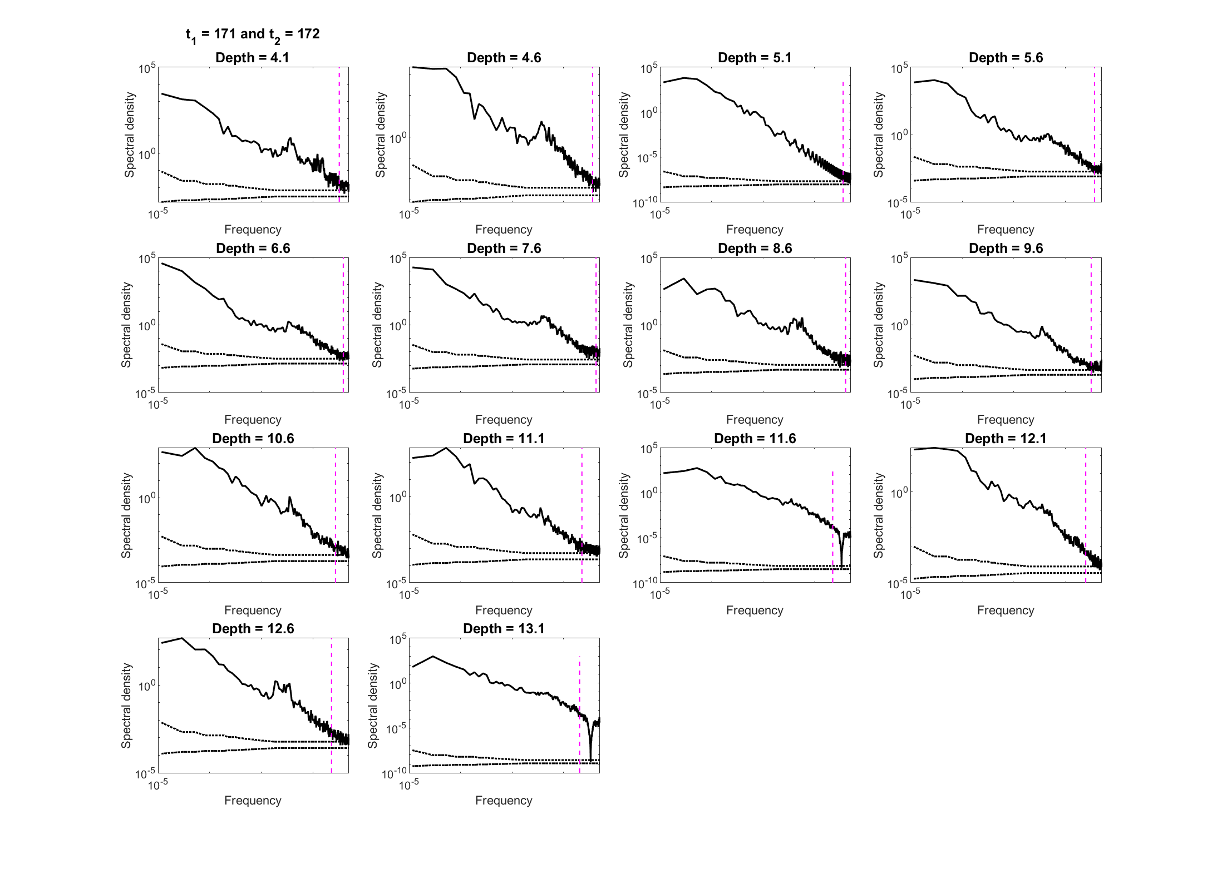
PSD at All Depths (1 day)

